Slide 1













Project presentation
Presented by : Boshra Ajeneh

Slide 2

Project Idea :
Building a scene from a very simple 2D
game consisting of a background, ground,
and a simple character.

Slide 3
Creating the window and floor and choosing appropriate colors.
01.
Project building steps
Building character , body, shape, color....
02.
To create a project idea, you must first make it exist and then work on improving and developing it.
Here are some steps for building this idea:
Start adding movements:
move right, left, jump, blink.
03.

Slide 4
  What are the problems ?
01
02
03
Separating moving and stationary objects.
When the character moves, the ground should not move .
Make the character move as a single unit, and link the keys to the movement.
Determine when the character collides with the point and makes it disappear.

Slide 5

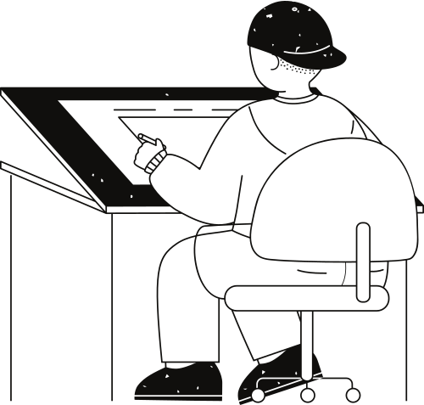
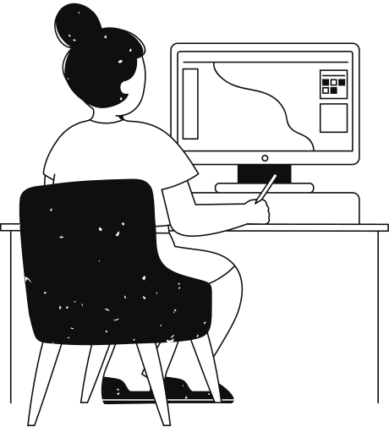

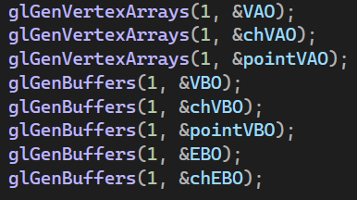
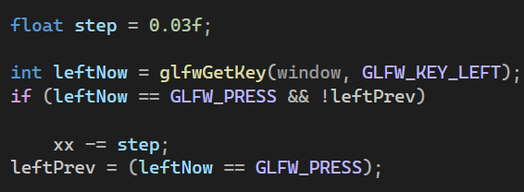
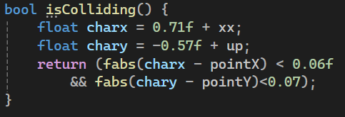
At first, all my objects were inside one VAO, so when I moved the character, the ground and the point also moved. To fix this, I separated them into different VAOs. Now each object has its own data and its own transformations, so I can control them independently.
when I pressed a movement key, the character kept moving until it went outside the screen. This happened because I was only checking the current key state and I had no movement limits. I solved this by tracking the previous and current key states
To detect collision, I first calculated the real position of the character by adding its base center to the movement uniforms. Then I compared the distance between the character’s center and the point.
.
If the distance was smaller than a chosen threshold, I considered it a collision. This allowed me to detect when the character touched the point accurately.
The solutions

Slide 6
Thank you very much!

